Slide 1
kathara lab
DNS
Version | 2.0
Author(s) | L. Ariemma, T. Caiazzi, G. Di Battista, M. Patrignani, M. Pizzonia, F. Ricci, M. Rimondini
E-mail | contact@kathara.org
Web | http://www.kathara.org/
Description | using the domain name system – kathara version of an existing netkit lab

Slide 2
copyright notice
All the pages/slides in this presentation, including but not limited to, images, photos, animations, videos, sounds, music, and text (hereby referred to as “material”) are protected by copyright.
This material, with the exception of some multimedia elements licensed by other organizations, is property of the authors and/or organizations appearing in the first slide.
This material, or its parts, can be reproduced and used for didactical purposes within universities and schools, provided that this happens for non-profit purposes.
Information contained in this material cannot be used within network design projects or other products of any kind.
Any other use is prohibited, unless explicitly authorized by the authors on the basis of an explicit agreement.
The authors assume no responsibility about this material and provide this material “as is”, with no implicit or explicit warranty about the correctness and completeness of its contents, which may be subject to changes.
This copyright notice must always be redistributed together with the material, or its portions.

Slide 3
purpose of this lab
get familiar with DNS
observe the behavior of name servers and their interactions
learn simple DNS configurations

Slide 4
lab limitations
DNS security issues and protocols are not covered
we use a version of Bind, which currently is the most widely used domain name server software, that allows ignoring security aspects
all IP addresses are IPv4

Slide 5
about the DNS
takes care of associating names with IP addresses
the name system is distributed over several nodes (hosts) that are hierarchically organized to form a tree
each node in the hierarchy corresponds to a name
a domain in the name system is a subtree
a node in the hierarchy may be delegated to handle names for a particular zone
such a node is an authoritative server for that zone
a zone is a domain which is devoid of those nodes having a different authoritative server (i.e., a tree without subtrees)

Slide 6
the DNS name hierarchy
each node corresponds
to a name
“”
this node is startup.net
it
dnsroot
net
uniroma3
dnsit
dnsnet
startup
localuni
pc1
dnsuni
localstart
pc2
dnsstart
this node is pc1.uniroma3.it

Slide 7
the DNS name hierarchy
startup.net domain
domains are subtrees
their name is the name of the root node
every node (including leaves) defines a domain
domains do overlap
“”
net domain
org
net
dnsroot
uniroma3
startup
dnsit
dnsnet
localuni
pc1
dnsuni
dnsstart
pc2
localstart

Slide 8
the DNS name hierarchy
leaves always correspond to real hosts
“”
intermediate nodes may correspond to real hosts (in this example they do not)
it
net
dnsroot
uniroma3
startup
dnsit
dnsnet
localuni
pc1
dnsuni
dnsstart
pc2
localstart

Slide 9
zones
a zone is a domain without the delegated subdomains
“”
zones cannot overlap
each node falls into a single zone
it
net
dnsroot
uniroma3
startup
dnsit
dnsnet
localuni
pc1
dnsuni
dnsstart
pc2
localstart

Slide 10
zones
zones have name servers
they are not constrained to be inside the zone they serve
served by
dnsit.it
“”
served by dnsroot
it
net
served by
dnsnet.net
dnsroot
uniroma3
startup
dnsit
dnsnet
localuni
pc1
dnsuni
dnsstart
pc2
localstart
served by dnsuni.uniroma3.it
served by dnsstart.startup.net

Slide 11
more about the DNS
the dns hierarchy is largely orthogonal with respect to the actual network topology
in order to focus on the behavior of the dns we choose a flat topology, consisting of a single collision domain

Slide 12
step 1 – network topology
dnsroot
abc
machine name
.5
dnsit
dnsnet
.1
.2
dnsuni
startup
.11
.22
localuni
pc1
pc2
localstart
.110
.111
.222
.220
192.168.0.0/24

Slide 13
step 1 – DNS (zone) hierarchy
“”
abc
domain name
it
net
served by
dnsroot
uniroma3
startup
pc1
served by
dnsit.it
pc2
served by
dnsnet.net
served by
dnsuni.uniroma3.it
served by
dnsstart.startup.net

Slide 14
step 2 – starting the lab
the lab is configured to
start all the 9 devices
automatically configure network interfaces (IPv4 only)
automatically configure the authoritative name servers
automatically configure name servers offering a recursive resolution service
automatically start the name server software (bind) on each name server
the daemon corresponding to bind is called named

Slide 15
step 2 – exploring the configuration
configuration on the PCs consists of the specification of the default name server
localuni.uniroma3.it
perform first IPv4 and then IPv6 queries
root@pc1:~$ cat /etc/resolv.conf
nameserver 192.168.0.110
search uniroma3.it
options single-request
suffix to append to unqualified names (e.g., asking to resolve dummy results in querying for dummy.uniroma3.it)
root@pc2:~$ cat /etc/resolv.conf
nameserver 192.168.0.220
search startup.net
options single-request
localstart.startup.net

Slide 16
step 2 – exploring the configuration
configuration on the name servers specifies
associations between zones and name servers
information about the root name servers
authoritative information
associations between names and IP addresses
authorization to resolve recursive queries

Slide 17
step 2 – exploring the configuration
configuration on the name servers specifies
associations between zones and name servers
include some additional configuration
root@dnsuni:~$ cat /etc/bind/named.conf
include "/etc/bind/named.conf.options";
zone "." {
type hint;
file "/etc/bind/db.root";
};
zone "uniroma3.it" {
type master;
file "/etc/bind/db.it.uniroma3";
};
where to find information about the root name server
we are the primary master for zone uniroma3.it
where to find data about the names in this zone
kathara – [ lab: dns ]

Slide 18
step 2 – exploring the configuration
configuration on the name servers specifies
additional configuration
root@dnsuni:~$ cat /etc/bind/named.conf.options
options {
directory "/var/cache/bind";
};
use this folder to store the cache.
COMPULSORY, otherwise, named wont ‘t start

Slide 19
format of a resource record
<domain> <class> <type> <rdata>
domain: the record owner (=domain to which the record refers)
class: usually IN (=Internet system); may be HS (=hesiod) or CH (=chaos)
type: see next slide...
rdata: record data (depends on the record type)

Slide 20
step 2 – exploring the configuration
available record types
A a host address.
A6 Obsolete format of IPv6 address.
AAAA an IPv6 address.
AFSDB (x) location of AFS database servers. Experimental.
CERT holds a digital certificate.
CNAME identifies the canonical name of an alias.
DNAME for delegation of reverse addresses. Replaces the domain name specified with
another name to be looked up. Described in RFC 2672.
GPOS Specifies the global position. Superseded by LOC.
HINFO identifies the CPU and OS used by a host.
ISDN (x) representation of ISDN addresses. Experimental.
KEY stores a public key associated with a DNS name.
KX identifies a key exchanger for this DNS name.
LOC (x) for storing GPS info. See RFC 1876. Experimental.
MX identifies a mail exchange for the domain. See RFC 974 for details.
NAPTR name authority pointer.
NSAP a network service access point.
NS the authoritative nameserver for the domain.
NXT used in DNSSEC to securely indicate that RRs with an owner name in a certain
name interval do not exist in a zone and indicate what R
PTR a pointer to another part of the domain name space.
PX provides mappings between RFC 822 and X.400 addresses.
RP (x) information on persons responsible for the domain. Experimental.
RT (x) route-through binding for hosts that do not have their own direct wide area
network addresses. Experimental.
SIG ("signature") contains data authenticated in the secure DNS. See RFC 2535 for
details.
SOA identifies the start of a zone of authority.
SRV information about well known network services (replaces WKS).
TXT text records.
WKS (h) information about which well known network services, such as SMTP, that a
domain supports. Historical, replaced by newer RR SRV.
X25 (x) representation of X.25 network addresses. Experimental
kathara – [ lab: dns ]
last update: Nov 2018

Slide 21
step 2 – exploring the configuration
configuration on the name servers specifies
information about the root name servers
a resource record
root@dnsuni:~$ cat /etc/bind/db.root
. IN NS ROOT-SERVER.
ROOT-SERVER. IN A 192.168.0.5
kathara – [ lab: dns ]

Slide 22
step 2 – exploring the configuration
configuration on the name servers specifies
authoritative information
root@dnsuni:~$ cat /etc/bind/db.it.uniroma3
$TTL 60000
time to live, in seconds (determines how long a resource record should be cached)

Slide 23
step 2 – exploring the configuration
configuration on the name servers specifies
authoritative information
root@dnsuni:~$ cat /etc/bind/db.it.uniroma3
$TTL 60000
@ IN SOA dnsuni.uniroma3.it. root.dnsuni.uniroma3.it. (
2006031201 ; serial
28 ; refresh
14 ; retry
3600000 ; expire
0 ; negative cache ttl
)
Start of Authority record
must be all on a single line; line breaks can only be introduced when using parentheses
a zone data file can contain only one SOA record

Slide 24
step 2 – exploring the configuration
configuration on the name servers specifies
authoritative information
root@dnsuni:~$ cat /etc/bind/db.it.uniroma3
$TTL 60000
@ IN SOA dnsuni.uniroma3.it. root.dnsuni.uniroma3.it. (
2006031201 ; serial
28 ; refresh
14 ; retry
3600000 ; expire
0 ; negative cache ttl
)
all domain names in this data file that are not fully qualified (do not end with a ‘.’) are relative to the origin
the origin is the domain name in the zone statement of the server configuration file:
zone "uniroma3.it" {
type master;
file "/etc/bind/db.it.uniroma3";
};
this record is referred to the current origin (uniroma3.it)

Slide 25
step 2 – exploring the configuration
configuration on the name servers specifies
authoritative information
root@dnsuni:~$ cat /etc/bind/db.it.uniroma3
$TTL 60000
@ IN SOA dnsuni.uniroma3.it. root.dnsuni.uniroma3.it. (
2006031201 ; serial
28 ; refresh
14 ; retry
3600000 ; expire
0 ; negative cache ttl
)
primary master (=authority) server for this zone (dnsuni.uniroma3.it);
don’t forget the trailing dot, or the origin name (uniroma3.it) would be appended!

Slide 26
step 2 – exploring the configuration
configuration on the name servers specifies
authoritative information
root@dnsuni:~$ cat /etc/bind/db.it.uniroma3
$TTL 60000
@ IN SOA dnsuni.uniroma3.it. root.dnsuni.uniroma3.it. (
2006031201 ; serial
28 ; refresh
14 ; retry
3600000 ; expire
0 ; negative cache ttl
)
the first ‘.’ must be replaced by a ‘@’
only meant to be used by humans; has no use within the dns service
mail address of the person that is responsible for the zone
(root@dnsuni.uniroma3.it)

Slide 27
step 2 – exploring the configuration
configuration on the name servers specifies
authoritative information
root@dnsuni:~$ cat /etc/bind/db.it.uniroma3
$TTL 60000
@ IN SOA dnsuni.uniroma3.it. root.dnsuni.uniroma3.it. (
2006031201 ; serial
28 ; refresh
14 ; retry
3600000 ; expire
0 ; negative cache ttl
)
makes sense for master/slave server configurations

Slide 28
step 2 – exploring the configuration
configuration on the name servers specifies
authoritative information
root@dnsuni:~$ cat /etc/bind/db.it.uniroma3
$TTL 60000
@ IN SOA dnsuni.uniroma3.it. root.dnsuni.uniroma3.it. (
2006031201 ; serial
28 ; refresh
14 ; retry
3600000 ; expire
0 ; negative cache ttl
)
serial number
determines how recent the information is
influences all data within the zone
conventional format: YYYYMMDDNN (year, month, day, # of changes within that day)

Slide 29
step 2 – exploring the configuration
configuration on the name servers specifies
authoritative information
root@dnsuni:~$ cat /etc/bind/db.it.uniroma3
$TTL 60000
@ IN SOA dnsuni.uniroma3.it. root.dnsuni.uniroma3.it. (
2006031201 ; serial
28 ; refresh
14 ; retry
3600000 ; expire
0 ; negative cache ttl
)
refresh interval
(seconds)
tells a slave how often to check that the data for this zone is up to date

Slide 30
step 2 – exploring the configuration
configuration on the name servers specifies
authoritative information
root@dnsuni:~$ cat /etc/bind/db.it.uniroma3
$TTL 60000
@ IN SOA dnsuni.uniroma3.it. root.dnsuni.uniroma3.it. (
2006031201 ; serial
28 ; refresh
14 ; retry
3600000 ; expire
0 ; negative cache ttl
)
interval (seconds) between subsequent attempts to contact the master

Slide 31
step 2 – exploring the configuration
configuration on the name servers specifies
authoritative information
root@dnsuni:~$ cat /etc/bind/db.it.uniroma3
$TTL 60000
@ IN SOA dnsuni.uniroma3.it. root.dnsuni.uniroma3.it. (
2006031201 ; serial
28 ; refresh
14 ; retry
3600000 ; expire
0 ; negative cache ttl
)
if the slave fails to contact the master for this amount of time, it considers the zone data too old and stops giving answers about it
slave expire time
(seconds)

Slide 32
step 2 – exploring the configuration
configuration on the name servers specifies
authoritative information
root@dnsuni:~$ cat /etc/bind/db.it.uniroma3
$TTL 60000
@ IN SOA dnsuni.uniroma3.it. root.dnsuni.uniroma3.it. (
2006031201 ; serial
28 ; refresh
14 ; retry
3600000 ; expire
0 ; negative cache ttl
)
ttl for negative responses from authoritative name servers

Slide 33
step 2 – exploring the configuration
configuration on the name servers specifies
associations between names and ip addresses
root@dnsuni:~$ cat /etc/bind/db.it.uniroma3
$TTL 60000
@ IN SOA dnsuni.uniroma3.it. root.dnsuni.uniroma3.it. (
2006031201 ; serial
28 ; refresh
14 ; retry
3600000 ; expire
0 ; negative cache ttl
)
@ IN NS dnsuni.uniroma3.it.
dnsuni.uniroma3.it. IN A 192.168.0.11
pc1.uniroma3.it. IN A 192.168.0.111
record type NS
(name server)
the authoritative name server for this zone (uniroma3.it) is dnsuni.uniroma3.it

Slide 34
step 2 – exploring the configuration
configuration on the name servers specifies
associations between names and ip addresses
root@dnsuni:~$ cat /etc/bind/db.it.uniroma3
$TTL 60000
@ IN SOA dnsuni.uniroma3.it. root.dnsuni.uniroma3.it. (
2006031201 ; serial
28 ; refresh
14 ; retry
3600000 ; expire
0 ; negative cache ttl
)
@ IN NS dnsuni.uniroma3.it.
dnsuni.uniroma3.it. IN A 192.168.0.11
pc1.uniroma3.it. IN A 192.168.0.111
record type A
(address)
two machines in this zone:
dnsuni.uniroma3.it
pc1.uniroma3.it

Slide 35
step 2 – exploring the configuration
configuration on the name servers specifies
associations between names and ip addresses
root@dnsit:~$ tail –n 5 /etc/bind/db.it
@ IN NS dnsit.it.
dnsit.it. IN A 192.168.0.1
uniroma3.it. IN NS dnsuni.uniroma3.it.
dnsuni.uniroma3.it. IN A 192.168.0.11
dnsit.it is the authority for this zone (it)
dnsuni.uniroma3.it is the authority for zone uniroma3(.it)

Slide 36
step 2 – exploring the configuration
configuration on the name servers specifies
allowing recursive queries and disabling dnssec
root@localuni:~$ cat /etc/bind/named.conf.options
options {
directory "/var/cache/bind";
allow-recursion { 192.168.0.0/24; };
auto-dnssec off;
dnssec-validation no;
dnssec-enable no;
dnssec-lookaside no;
filter-aaaa-on-v4 yes;
send-cookie no;
};
disable dnssec
filter AAAA addresses on IPv4 only
allow recursive queries from 192.168.0.0/24
Do not send DNS cookies

Slide 37
let’s start the lab

Slide 38
step 3 – experiment setting
dnsroot
.5
dnsit
dnsnet
.1
.2
dnsuni
startup
.11
.22
localuni
pc1
pc2
localstart
.110
.111
.222
.220
192.168.0.0/24

Slide 39
sniff the traffic
connect the wireshark device to collision domain A
open any browser on the host machine
on localhost:3000
sniff eth1
user@localhost:~/kathara-lab_dns$ kathara lconfig -n wireshark --add A

Slide 40
step 3 – ping from pc1
Numeric output only. No attempt will be made to lookup symbolic names for host addresses.
execute a ping command towards pc2
pc1
root@pc1:/# ping -n pc2.startup.net
PING pc2.startup.net (192.168.0.222) 56(84) bytes of data.
64 bytes from 192.168.0.222: icmp_seq=1 ttl=64 time=1.50 ms
64 bytes from 192.168.0.222: icmp_seq=2 ttl=64 time=0.580 ms
64 bytes from 192.168.0.222: icmp_seq=3 ttl=64 time=0.525 ms
--- pc2.startup.net ping statistics ---
3 packets transmitted, 3 received, 0% packet loss, time 2010ms
rtt min/avg/max/mdev = 0.525/0.867/1.496/0.445 ms

Slide 41
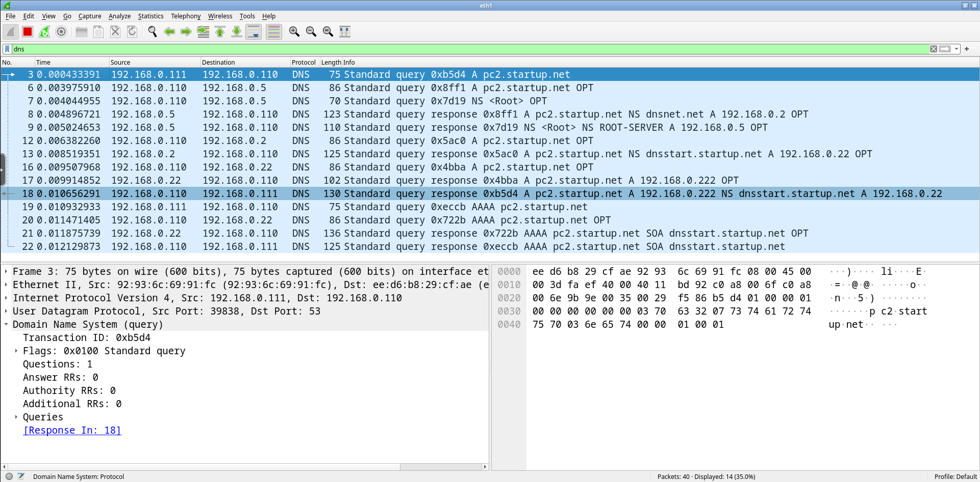
step 3 – the sniffer output

Slide 42
step 3 – the sniffer output
filter to only show DNS packets

Slide 43
step 3 – the sniffer output
pc1 asks to localuni
the address of pc2
query id
query value
query type
(address)

Slide 44
step 3 – the sniffer output
request root name servers
answer with all the authoritative root name servers

Slide 45
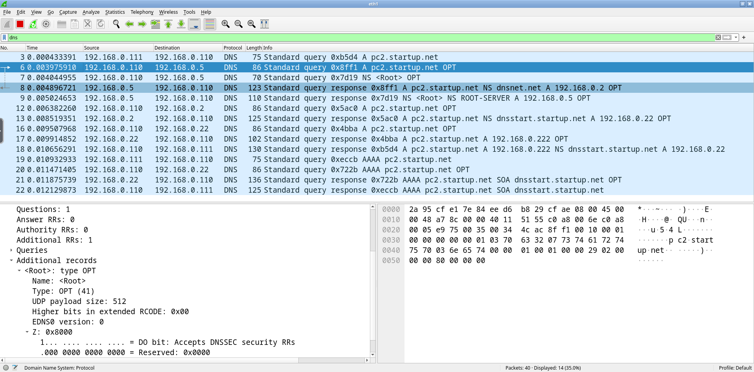
step 3 – the sniffer output
localuni asks dnsroot who is the name server for the net domain
dnsnet.net address is 192.168.0.2

Slide 46
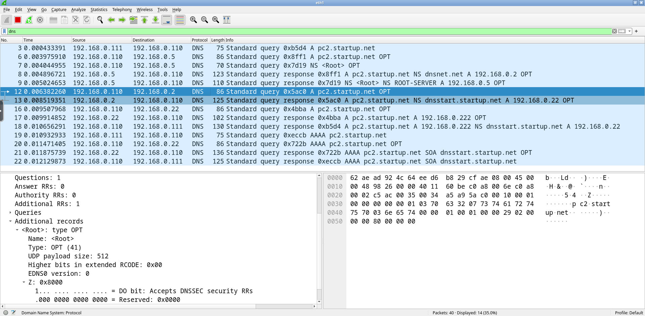
step 3 – the sniffer output
localuni asks dnsnet who is the name server for the startup.net domain
dnsstart.startup.net address is 192.168.0.22

Slide 47
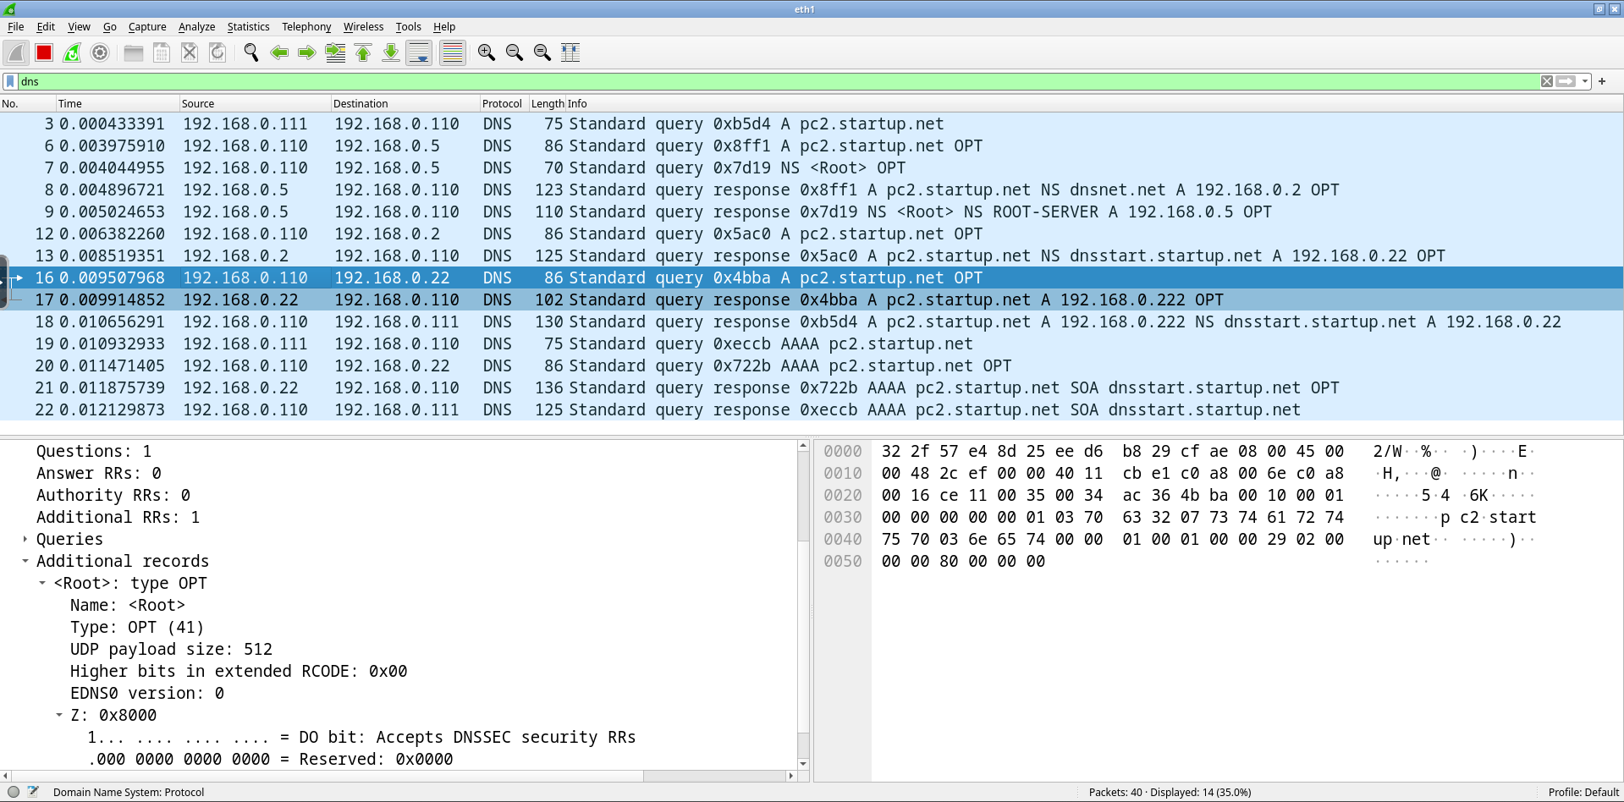
step 3 – the sniffer output
localuni asks dnsstart what is the address of pc2.startup.net
pc2.startup.net address is 192.168.0.222

Slide 48
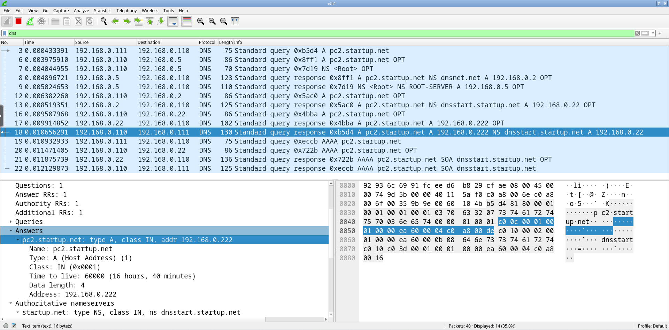
step 3 – the sniffer output
localuni reports to pc1 the addres of pc2.startup.net

Slide 49
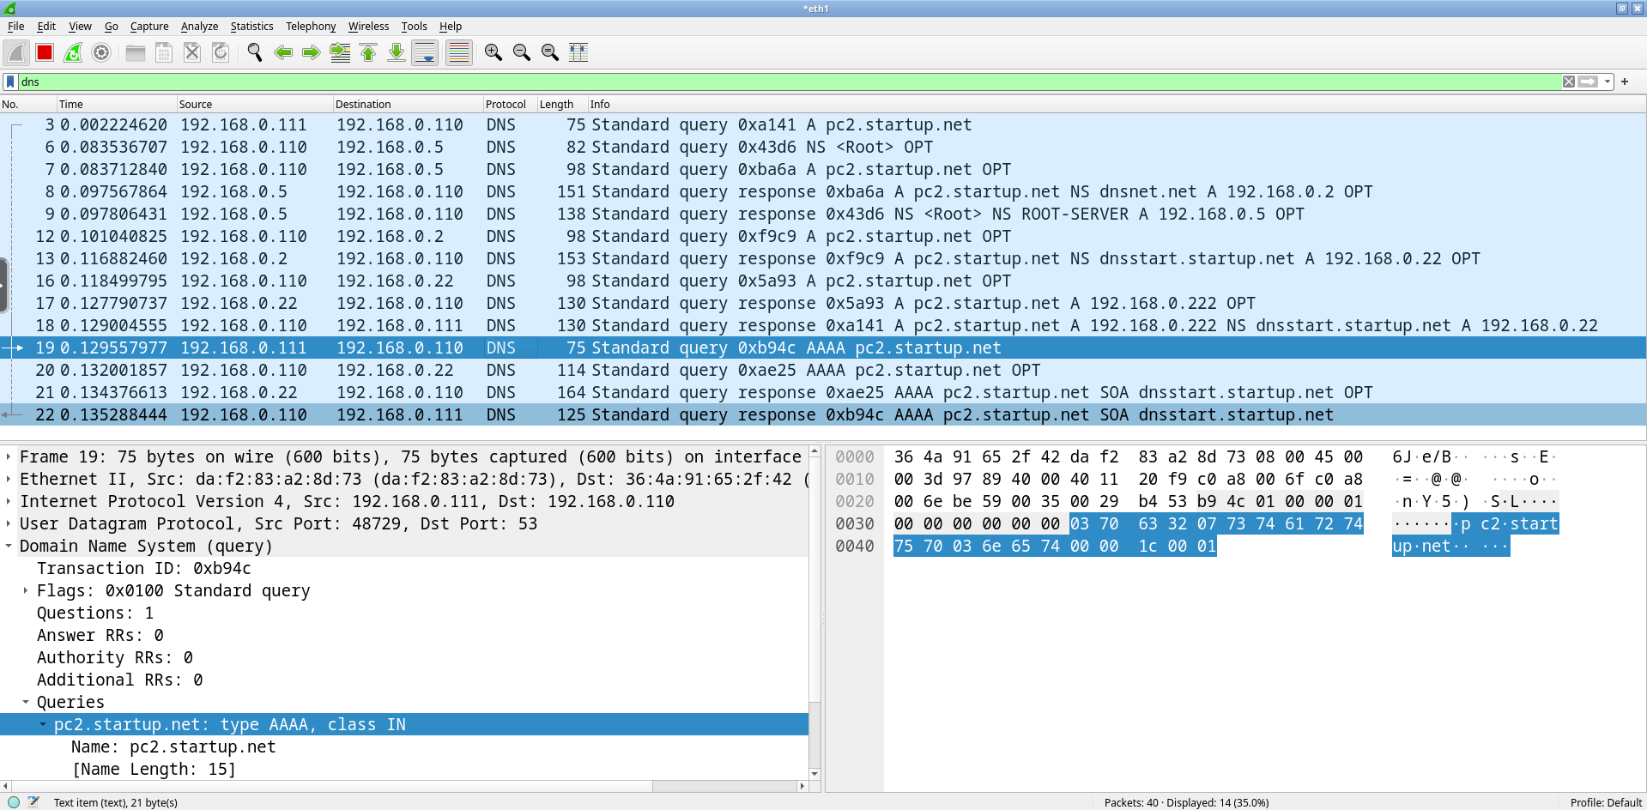
step 3 – the sniffer output
pc1 asks localuni for AAAA records of pc2.startup.net
localuni directly asks dnsstart (it already knows it) for AAAA records of pc2.startup.net
dnsstart returns a SOA record, indicating that it does not have any AAAA record for pc2.startup.net
localuni reports dnsstart answer to pc1

Slide 50
step 3 – exchanged messages
dnsroot
abc
machine name
.5
dnsit
dnsnet
.1
.2
dnsuni
dnsstart
.11
.22
pc1
pc2
.111
.222
192.168.0.0/24

Slide 51
step 3 – exchanged messages
dnsroot
abc
machine name
.5
dnsit
dnsnet
.1
.2
dnsuni
dnsstart
.11
.22
pc1
pc2
.111
.222
192.168.0.0/24

Slide 52
step 3 – exchanged messages
dnsroot
abc
machine name
.5
dnsit
dnsnet
.1
.2
dnsuni
dnsstart
.11
.22
pc1
pc2
.111
.222
192.168.0.0/24

Slide 53
step 3 – exchanged messages
dnsroot
abc
machine name
.5
dnsit
dnsnet
.1
.2
dnsuni
dnsstart
.11
.22
pc1
pc2
.111
.222
192.168.0.0/24

Slide 54
step 3 – exchanged messages
dnsroot
abc
machine name
.5
dnsit
dnsnet
.1
.2
dnsuni
dnsstart
.11
.22
pc1
pc2
.111
.222
192.168.0.0/24

Slide 55
step 3 – exchanged messages
dnsroot
abc
machine name
.5
dnsit
dnsnet
.1
.2
dnsuni
dnsstart
.11
.22
pc1
pc2
.111
.222
192.168.0.0/24

Slide 56
step 3 – exchanged messages
dnsroot
abc
machine name
.5
dnsit
dnsnet
.1
.2
dnsuni
dnsstart
.11
.22
pc1
pc2
.111
.222
192.168.0.0/24

Slide 57
step 3 – exchanged messages
recursive behavior
dnsroot
abc
machine name
.5
dnsit
dnsnet
.1
.2
dnsuni
dnsstart
.11
.22
pc1
pc2
.111
.222
192.168.0.0/24

Slide 58
step 4 – repeating the experiment
execute a ping command towards pc2
pc1
root@pc1:/# ping -n pc2.startup.net
PING pc2.startup.net (192.168.0.222) 56(84) bytes of data.
64 bytes from 192.168.0.222: icmp_seq=1 ttl=64 time=1.50 ms
64 bytes from 192.168.0.222: icmp_seq=2 ttl=64 time=0.580 ms
64 bytes from 192.168.0.222: icmp_seq=3 ttl=64 time=0.525 ms
--- pc2.startup.net ping statistics ---
3 packets transmitted, 3 received, 0% packet loss, time 2010ms
rtt min/avg/max/mdev = 0.525/0.867/1.496/0.445 ms

Slide 59
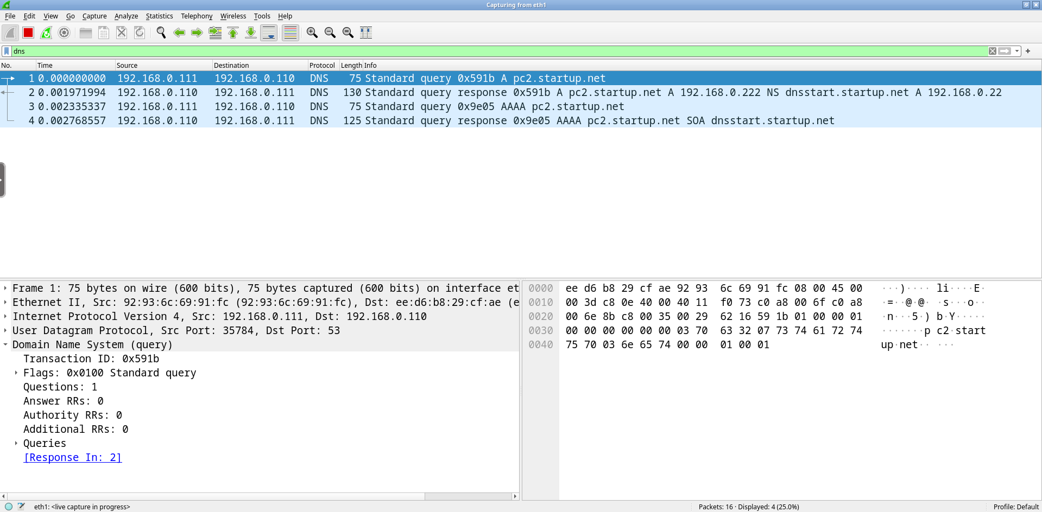
step 4 – repeating the experiment
the name server cache helps reducing traffic

Slide 60
step 4 – repeating the experiment
dnsroot
abc
machine name
.5
dnsit
dnsnet
.1
.2
dnsuni
dnsstart
.11
.22
pc1
pc2
.111
.222
192.168.0.0/24

Slide 61
step 5 – cleaning the cache
localuni
root@localuni:/# rndc flush
rndc controls the operation of a name server
the flush command cleans up caches
a new client query triggers the complete sequence of iterative queries

Slide 62
step 6 – ping non-existent target
execute a ping command towards a non-existent target
pc1
root@pc1:/# ping pluto.startup.net
ping: pluto.startup.net: Name or service not known

Slide 63
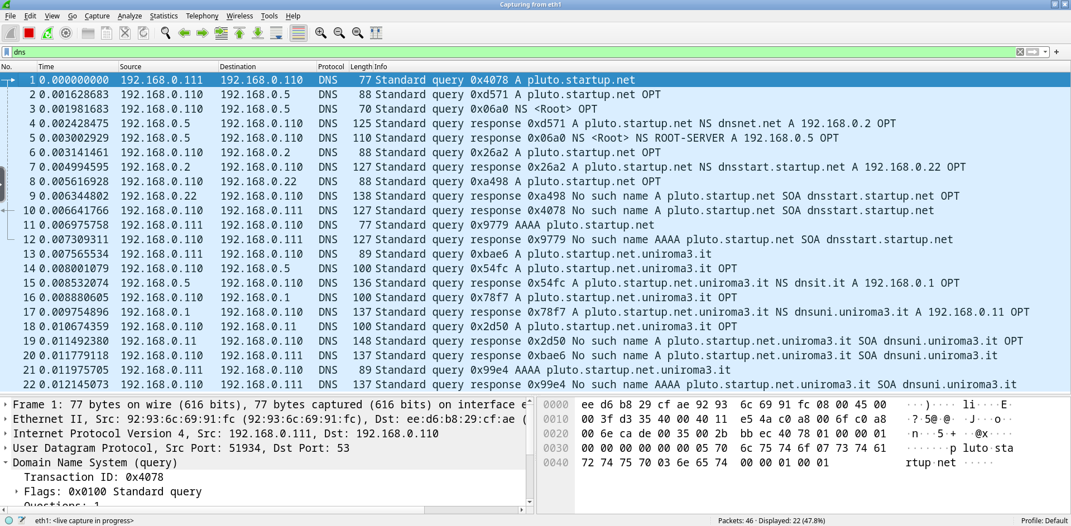
step 6 – non-existent target
all the iterative queries are performed again because of the cache flush
kathara – [ lab: dns ]

Slide 64
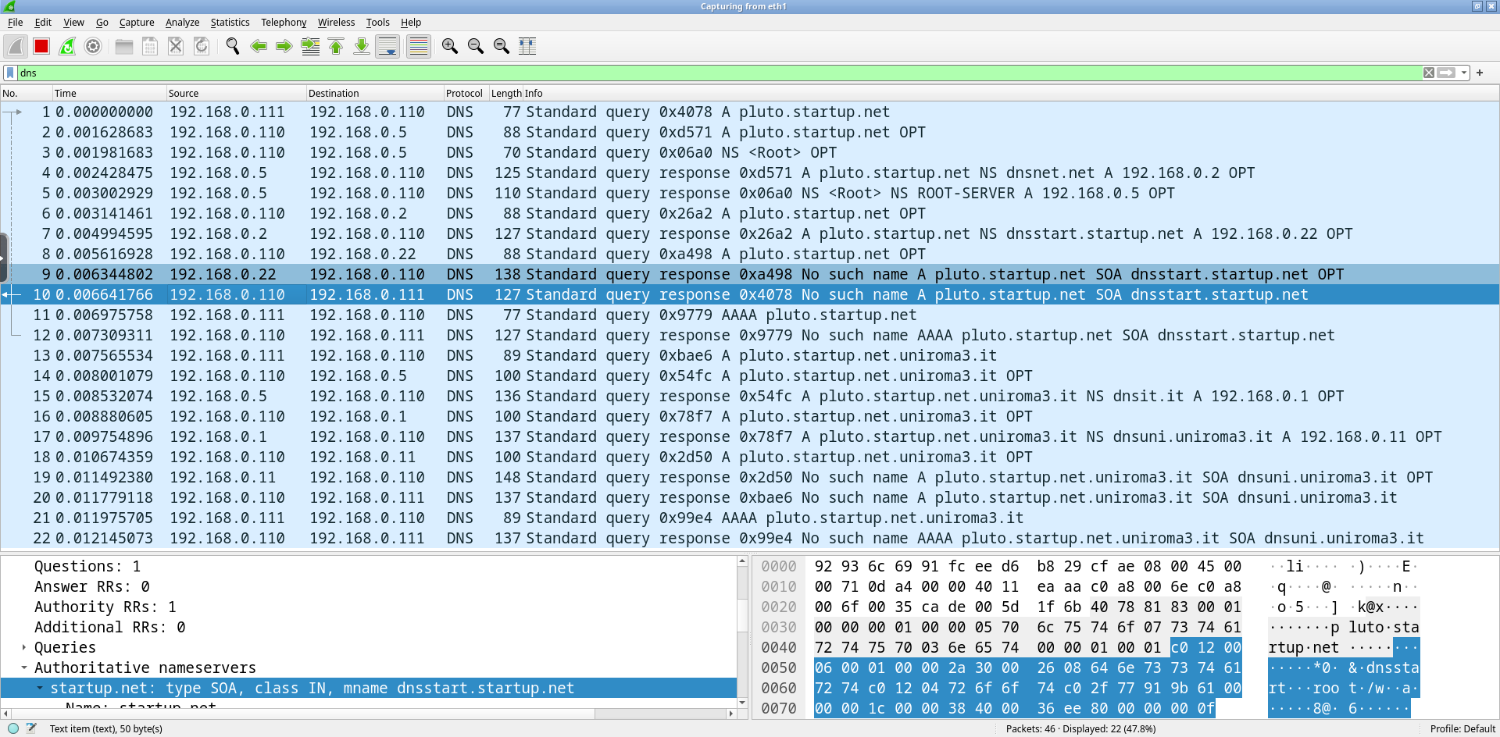
step 6 – non-existent target
the requested domain (pluto.startup.net) does not exist
kathara – [ lab: dns ]

Slide 65
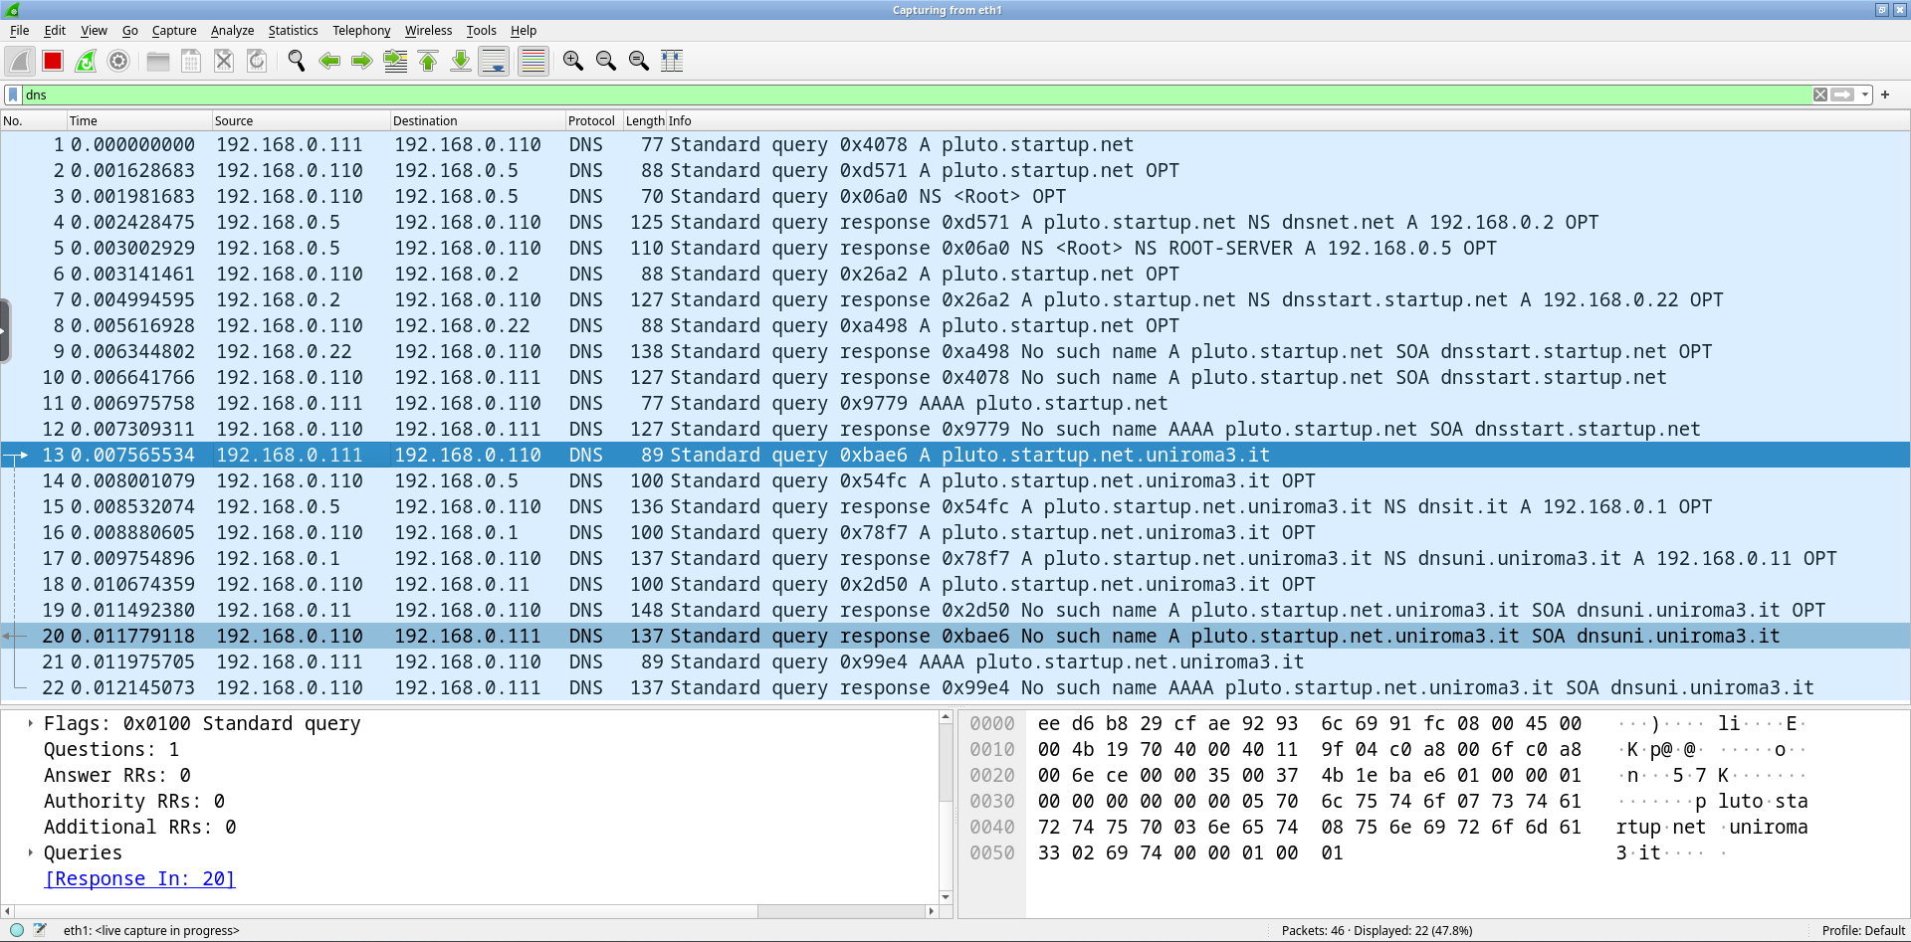
step 6 – non-existent target
since the query has failed, pc1 tries once more with the domain search path configured inside its /etc/resolv.conf:
nameserver 192.168.0.11
search uniroma3.it
kathara – [ lab: dns ]

Slide 66
step 6 – ping non-existent target
repeat the ping command towards the non-existent target
pc1
root@pc1:/# ping pluto.startup.net
ping: pluto.startup.net: Name or service not known

Slide 67
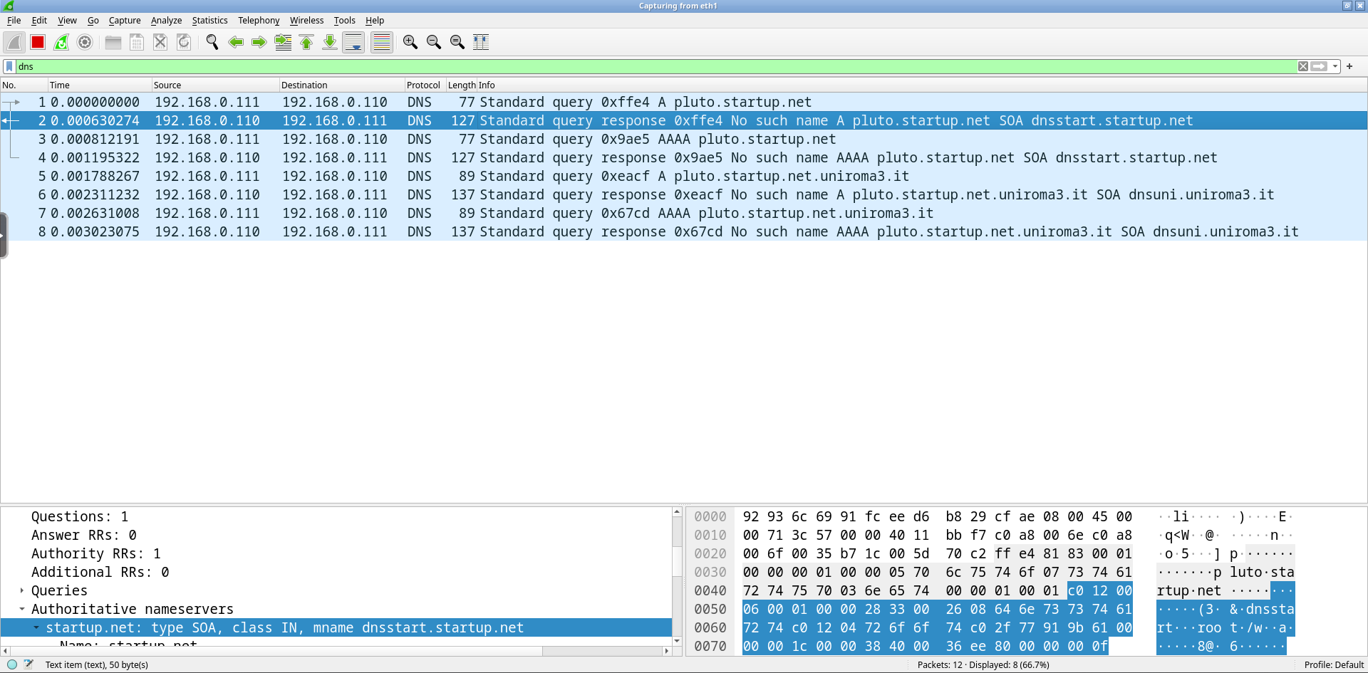
step 6 – ping non-existent target
the name server negative cache has stored the negative answer
as before, pc1 tries once more with the domain search path configured inside its /etc/resolv.conf
kathara – [ lab: dns ]

Slide 68
step 7 – advanced queries
resource records can be searched by using dig
highly customizable queries
detailed responses
pc1
root@pc1:/# dig pc2.startup.net

Slide 69
step 7 – advanced queries
pc1
root@pc1:/# dig pc2.startup.net
; <<>> DiG 9.18.19-1~deb12u1-Debian <<>> pc2.startup.net
;; global options: +cmd
;; Got answer:
;; ->>HEADER<<- opcode: QUERY, status: NOERROR, id: 22137
;; flags: qr rd ra; QUERY: 1, ANSWER: 1, AUTHORITY: 1, ADDITIONAL: 2
;; OPT PSEUDOSECTION:
; EDNS: version: 0, flags:; udp: 4096
; COOKIE: b4c95f2012cf8905d705a97c657b10f314be1a5abe3ec74d (good)
;; QUESTION SECTION:
;pc2.startup.net. IN A
;; ANSWER SECTION:
pc2.startup.net. 60000 IN A 192.168.0.222
;; AUTHORITY SECTION:
startup.net. 59173 IN NS dnsstart.startup.net.
;; ADDITIONAL SECTION:
dnsstart.startup.net. 59173 IN A 192.168.0.22
;; Query time: 0 msec
;; SERVER: 192.168.0.110#53(192.168.0.110) (UDP)
;; WHEN: Thu Dec 14 14:28:03 UTC 2023
;; MSG SIZE rcvd: 127
answer flags:
qr: query response
rd: recursion desired (the user asked for a recursive lookup)
ra: recursion available (the server allows recursive lookups)

Slide 70
step 7 – advanced queries
pc1
root@pc1:/# dig pc2.startup.net
; <<>> DiG 9.18.19-1~deb12u1-Debian <<>> pc2.startup.net
;; global options: +cmd
;; Got answer:
;; ->>HEADER<<- opcode: QUERY, status: NOERROR, id: 22137
;; flags: qr rd ra; QUERY: 1, ANSWER: 1, AUTHORITY: 1, ADDITIONAL: 2
;; OPT PSEUDOSECTION:
; EDNS: version: 0, flags:; udp: 4096
; COOKIE: b4c95f2012cf8905d705a97c657b10f314be1a5abe3ec74d (good)
;; QUESTION SECTION:
;pc2.startup.net. IN A
;; ANSWER SECTION:
pc2.startup.net. 60000 IN A 192.168.0.222
;; AUTHORITY SECTION:
startup.net. 59173 IN NS dnsstart.startup.net.
;; ADDITIONAL SECTION:
dnsstart.startup.net. 59173 IN A 192.168.0.22
;; Query time: 0 msec
;; SERVER: 192.168.0.110#53(192.168.0.110) (UDP)
;; WHEN: Thu Dec 14 14:28:03 UTC 2023
;; MSG SIZE rcvd: 127
these sections correspond to those contained in DNS packets

Slide 71
step 7 – advanced queries
pc1
root@pc1:/# dig pc2.startup.net
; <<>> DiG 9.18.19-1~deb12u1-Debian <<>> pc2.startup.net
;; global options: +cmd
;; Got answer:
;; ->>HEADER<<- opcode: QUERY, status: NOERROR, id: 22137
;; flags: qr rd ra; QUERY: 1, ANSWER: 1, AUTHORITY: 1, ADDITIONAL: 2
;; OPT PSEUDOSECTION:
; EDNS: version: 0, flags:; udp: 4096
; COOKIE: b4c95f2012cf8905d705a97c657b10f314be1a5abe3ec74d (good)
;; QUESTION SECTION:
;pc2.startup.net. IN A
;; ANSWER SECTION:
pc2.startup.net. 60000 IN A 192.168.0.222
;; AUTHORITY SECTION:
startup.net. 59173 IN NS dnsstart.startup.net.
;; ADDITIONAL SECTION:
dnsstart.startup.net. 59173 IN A 192.168.0.22
;; Query time: 0 msec
;; SERVER: 192.168.0.110#53(192.168.0.110) (UDP)
;; WHEN: Thu Dec 14 14:28:03 UTC 2023
;; MSG SIZE rcvd: 127
records being searched
(class: IN, type: A ⇒ address records)
a dns message never contains more than one question section

Slide 72
step 7 – advanced queries
pc1
root@pc1:/# dig pc2.startup.net
; <<>> DiG 9.18.19-1~deb12u1-Debian <<>> pc2.startup.net
;; global options: +cmd
;; Got answer:
;; ->>HEADER<<- opcode: QUERY, status: NOERROR, id: 22137
;; flags: qr rd ra; QUERY: 1, ANSWER: 1, AUTHORITY: 1, ADDITIONAL: 2
;; OPT PSEUDOSECTION:
; EDNS: version: 0, flags:; udp: 4096
; COOKIE: b4c95f2012cf8905d705a97c657b10f314be1a5abe3ec74d (good)
;; QUESTION SECTION:
;pc2.startup.net. IN A
;; ANSWER SECTION:
pc2.startup.net. 60000 IN A 192.168.0.222
;; AUTHORITY SECTION:
startup.net. 59173 IN NS dnsstart.startup.net.
;; ADDITIONAL SECTION:
dnsstart.startup.net. 59173 IN A 192.168.0.22
;; Query time: 0 msec
;; SERVER: 192.168.0.110#53(192.168.0.110) (UDP)
;; WHEN: Thu Dec 14 14:28:03 UTC 2023
;; MSG SIZE rcvd: 127
records that form the answer to the question
may be more than one
time to live of a resource record that is cached on the server
try invoking dig once more to see it decreasing
constant if the record is not cached (i.e., it is stored on the name server being queried – by default the one configured in /etc/resolv.conf)

Slide 73
step 7 – advanced queries
pc1
root@pc1:/# dig pc2.startup.net
; <<>> DiG 9.18.19-1~deb12u1-Debian <<>> pc2.startup.net
;; global options: +cmd
;; Got answer:
;; ->>HEADER<<- opcode: QUERY, status: NOERROR, id: 22137
;; flags: qr rd ra; QUERY: 1, ANSWER: 1, AUTHORITY: 1, ADDITIONAL: 2
;; OPT PSEUDOSECTION:
; EDNS: version: 0, flags:; udp: 4096
; COOKIE: b4c95f2012cf8905d705a97c657b10f314be1a5abe3ec74d (good)
;; QUESTION SECTION:
;pc2.startup.net. IN A
;; ANSWER SECTION:
pc2.startup.net. 60000 IN A 192.168.0.222
;; AUTHORITY SECTION:
startup.net. 59173 IN NS dnsstart.startup.net.
;; ADDITIONAL SECTION:
dnsstart.startup.net. 59173 IN A 192.168.0.22
;; Query time: 0 msec
;; SERVER: 192.168.0.110#53(192.168.0.110) (UDP)
;; WHEN: Thu Dec 14 14:28:03 UTC 2023
;; MSG SIZE rcvd: 127
records describing authoritative name servers are returned here
additional records are returned here

Slide 74
step 8 – an iterative query
restart bind on the name server
perform an iterative query using dig
localuni
root@localuni:/# systemctl restart bind9
pc1
root@pc1:/# dig +noquestion +noadditional +norecurse pc2.startup.net
avoid displaying question and additional sections
disable recursion

Slide 75
step 8 – an iterative query
pc1
root@pc1:/# dig +noquestion +noadditional +norecurse pc2.startup.net
; <<>> DiG 9.18.19-1~deb12u1-Debian <<>> +noquestion +noadditional +norecurse pc2.startup.net
;; global options: +cmd
;; Got answer:
;; ->>HEADER<<- opcode: QUERY, status: NOERROR, id: 15543
;; flags: qr ra; QUERY: 1, ANSWER: 0, AUTHORITY: 1, ADDITIONAL: 1
;; OPT PSEUDOSECTION:
; EDNS: version: 0, flags:; udp: 4096
; COOKIE: 5ea4ced6cdaf30599571a9e0657b15c2381005312bcc21e9 (good)
;; AUTHORITY SECTION:
. 0 IN NS ROOT-SERVER.
;; Query time: 0 msec
;; SERVER: 192.168.0.110#53(192.168.0.110) (UDP)
;; WHEN: Thu Dec 14 14:48:34 UTC 2023
;; MSG SIZE rcvd: 96
the server answers by specifying the authoritative name server to be contacted to get the desired information

Slide 76
step 8 – an iterative query
pc1
root@pc1:/# dig +noquestion +noadditional +norecurse @192.168.0.5 pc2.startup.net
; <<>> DiG 9.18.19-1~deb12u1-Debian <<>> +noquestion +noadditional +norecurse @192.168.0.5 pc2.startup.net
; (1 server found)
;; global options: +cmd
;; Got answer:
;; ->>HEADER<<- opcode: QUERY, status: NOERROR, id: 24163
;; flags: qr ra; QUERY: 1, ANSWER: 0, AUTHORITY: 1, ADDITIONAL: 2
;; OPT PSEUDOSECTION:
; EDNS: version: 0, flags:; udp: 4096
; COOKIE: 301c8e7f8267ad01ed2cc63e657b1736676e072f5ecd90bf (good)
;; AUTHORITY SECTION:
net. 60000 IN NS dnsnet.net.
;; Query time: 0 msec
;; SERVER: 192.168.0.5#53(192.168.0.5) (UDP)
;; WHEN: Thu Dec 14 14:54:46 UTC 2023
;; MSG SIZE rcvd: 109
query a specific name server (dnsroot)
dnsnet.net is the authoritative name server for zone net

Slide 77
step 8 – an iterative query
pc1
root@pc1:/# dig +noquestion +noadditional +norecurse @192.168.0.2 pc2.startup.net
; <<>> DiG 9.18.19-1~deb12u1-Debian <<>> +noquestion +noadditional +norecurse @192.168.0.2 pc2.startup.net
; (1 server found)
;; global options: +cmd
;; Got answer:
;; ->>HEADER<<- opcode: QUERY, status: NOERROR, id: 42339
;; flags: qr ra; QUERY: 1, ANSWER: 0, AUTHORITY: 1, ADDITIONAL: 2
;; OPT PSEUDOSECTION:
; EDNS: version: 0, flags:; udp: 4096
; COOKIE: d96ea5b92e6860aeed2cc63e657b1878e06d204302aa8149 (good)
;; AUTHORITY SECTION:
startup.net. 60000 IN NS dnsstart.startup.net.
;; Query time: 9 msec
;; SERVER: 192.168.0.2#53(192.168.0.2) (UDP)
;; WHEN: Thu Dec 14 15:00:08 UTC 2023
;; MSG SIZE rcvd: 111
query a specific name server (dnsnet.net)
dnsstart.startup.net is the authoritative name server for zone startup.net

Slide 78
step 8 – an iterative query
pc1
root@pc1:/# dig +noquestion +noadditional +norecurse @192.168.0.22 pc2.startup.net
; <<>> DiG 9.18.19-1~deb12u1-Debian <<>> +noquestion +noadditional +norecurse @192.168.0.22 pc2.startup.net
; (1 server found)
;; global options: +cmd
;; Got answer:
;; ->>HEADER<<- opcode: QUERY, status: NOERROR, id: 49113
;; flags: qr aa ra; QUERY: 1, ANSWER: 1, AUTHORITY: 1, ADDITIONAL: 2
;; OPT PSEUDOSECTION:
; EDNS: version: 0, flags:; udp: 4096
; COOKIE: b119e8f8b644792eb3bafbd6657b17989cd95e340adb2072 (good)
;; ANSWER SECTION:
pc2.startup.net. 60000 IN A 192.168.0.222
;; AUTHORITY SECTION:
startup.net. 60000 IN NS dnsstart.startup.net.
;; Query time: 0 msec
;; SERVER: 192.168.0.22#53(192.168.0.22) (UDP)
;; WHEN: Thu Dec 14 14:56:24 UTC 2023
;; MSG SIZE rcvd: 127
query a specific name server (dnsstart.startup.net )
the address of pc2.startup.net

